Slide 1
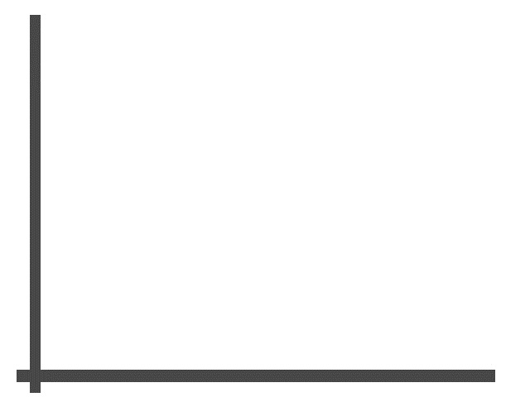
Test case
Ha Nguyen

Slide 2





Agenda
What is test case?
Test case guideline
Tips for good test case
Test case review
Corner for you

Slide 3

What is test case?
A set of pre-requisites/pre-conditions, test steps, input value, expected results

Slide 4



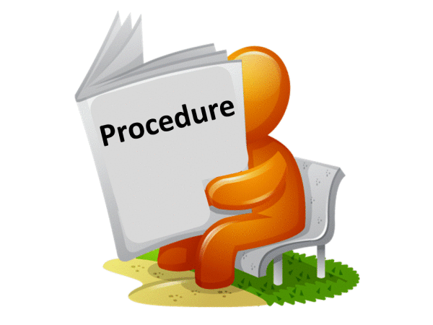


Test case guideline
Test case ID
Test case Subject
Test case elements
Test case description
Test Case Procedure
Expected Output
Inter-test case Dependence

Slide 5




Unique number to identify test case. It should be ID to:
Easy to say it belong to which module
Easy to add new one into one module and don’t change ID of other
Should not replaced by deleted one
Test case ID
Login_01
Login_02
Register_01
Register_02
…

Slide 6

Test case Subject
Subject to describe the content
Verify that user can login with username and password are valid successfully

Slide 7
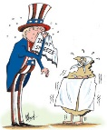
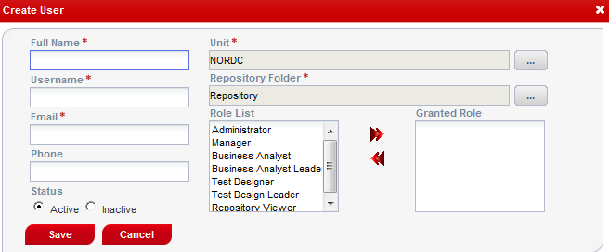
The description of objective or condition
Test case description
Can not add user without email
Can not add duplicated user name
Can not add user with special characters
…

Slide 8
A set of steps/actions need to be run to complete
a particular objective or condition
Test case procedure
On User list screen, click on [+] button
Input username that not existed (E.g. “test”)
Input Full name, email (E.g. “test”, testinsight@sharp-in-u.com )
Use other values by default and click on [Save] button

Slide 9

Expected Output
A set of output/result after run
Create User screen is displayed
2-4. “test” is displayed in User list with order of username,
number of list increase one

Slide 10

One or more test cases what is input for others.
If they are blocked, we can not run next cases
Inter-test case Dependence
Login_01

Slide 11

A set of actions need to be done before run a case.
It maybe set for one or a set of test cases
Pre-requisite
Open IE
Access to http://10.16.51.8/TestInsight
Login with Admin role (admin/admin)
Select Admin menu and then User menu item
Search to ensure that user test not existed (E.g. “test”)

Slide 12

Tips for good Test case
Structure of TC is clear and reasonable.
Follow requirement closely
Title easy to understand and cover requirement (as user, I can do or can’t do…)
Cover all of cases that can occur
Test step and expected result is a step by step process

Slide 13

Test Case Review Checklist
What is test case checklist?
Common questions to ensure that TC
created enough and right format
Reviewer (Test leader, PM, Developers,
QA, customer)
Who do?

Slide 14

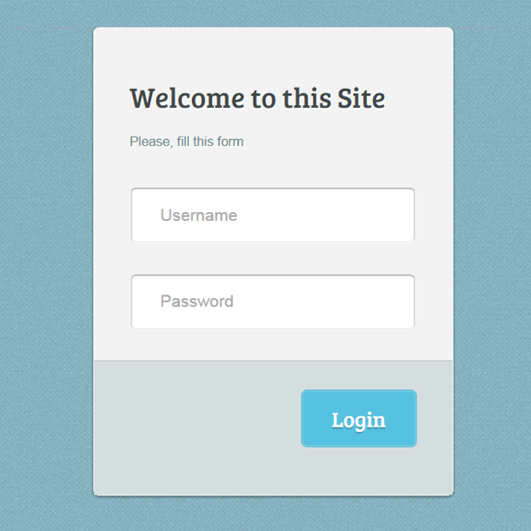



Corner for you
User Name & Password are valid -> Login is successful
User Name is valid, Password is empty -> Login is fail
User Name is a space, Password is valid -> Login is fail
User Name and Password are empty -> Login is fail
User Name and Password are valid, your account is inactive -> Login is fail
Create these test cases and upload to Sakai tool

Slide 15

Thanks for your listening

